Slide 1

Welcome To Preetham Motors

Slide 2

Prepared By : - Abhiram Gopisetty
Akash Shinde
Soumya Machavarapu
Akshada Khadangle
Guided By : -
Annu Sharma

Slide 3

Introduction
Preetham Motors is your go to website for all your secondhand car needs. We understand that buying a car can be a daunting task, but with our expertise and experience, we make it easy and hassle-free for you. At Preetham Motors, we follow a simple and transparent process for buying a car. You can start by browsing our extensive collection of cars on our website. Once you have selected a car that you like, It will be yours . We also offer test drives so that you can get a feel for the car before making a decision.

Slide 4

Selling Your Car with Preetham Motors
At Preetham Motors, we make it easy for you to sell your car. All you need to do is fill out our simple seller form, providing us with some basic information about your vehicle, such as its make, model, and year of manufacture. Once we receive your form, one of our experienced evaluators will assess your car's condition and provide you with a fair market value for it.So why wait? Sell your car to Preetham Motors today and get the best value for it.

Slide 5
Existing System
In the existing system, the registered users and unregistered users both can view the buy/sell used cars with some searching criteria like color, company etc.
The existing system is paid and in this system commission is taken for buying used cars.

Slide 6
Proposed System
In our new system, buyers and sellers can search/sell used cars only after registration and logging in.
In our new system, no system commission is taken for buying used cars.

Slide 7
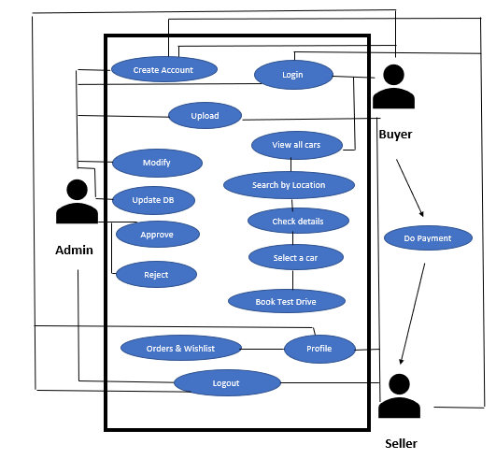
Quick Demo

Slide 8
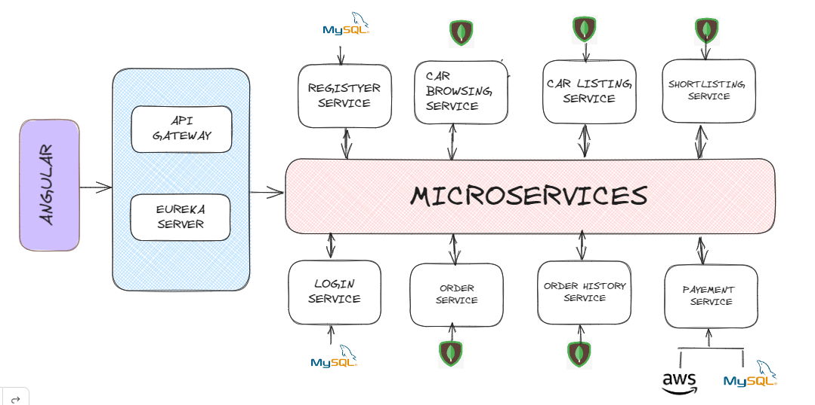
Architecture

Slide 9
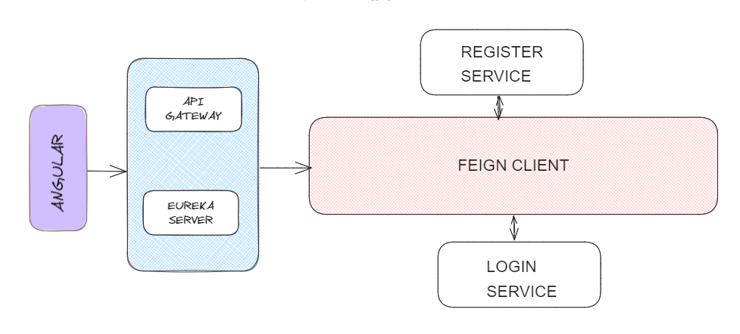
Feign Client

Slide 10
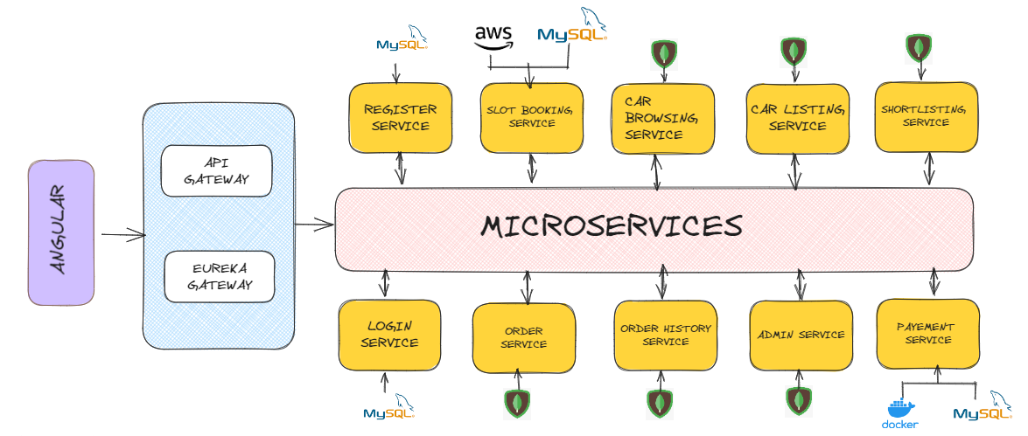
Microservices

Slide 11
Database Selection
MongoDB can provide high-performance reads and writes, especially for scenarios that involve large amounts of data and frequent write operations.
MySQL is optimized for transactional operations and can handle concurrent read and write operations efficiently. It offers features such as indexing, caching, and query optimization to improve performance.

Slide 12
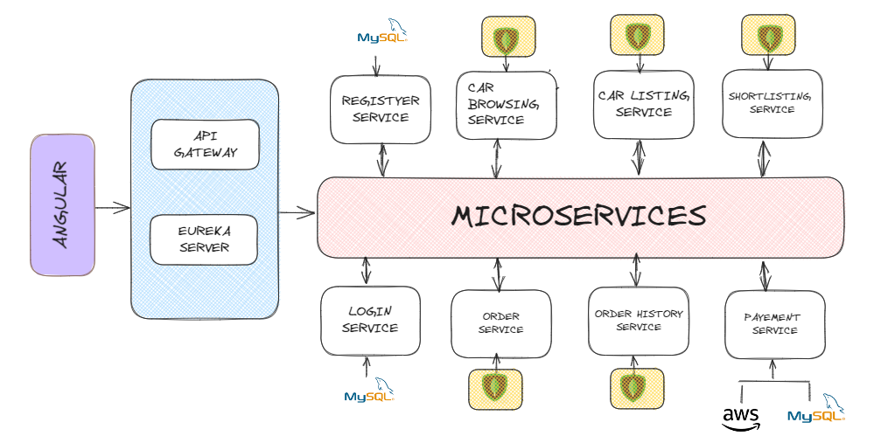
MongoDB

Slide 13
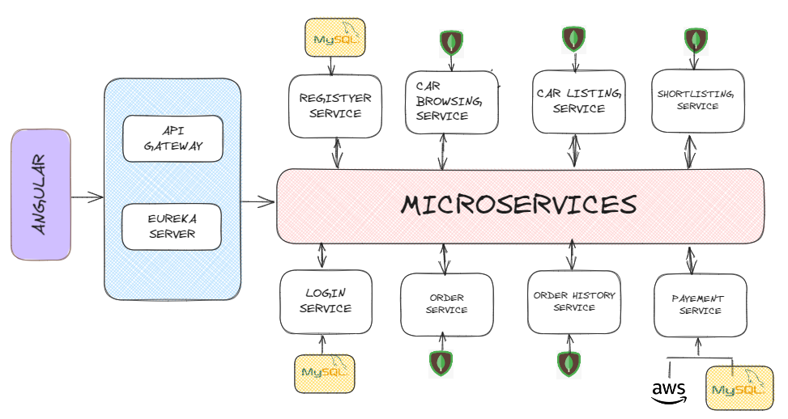
MySQL

Slide 14
Microservices Pattern
Eureka Server
Api-Gateway

Slide 15
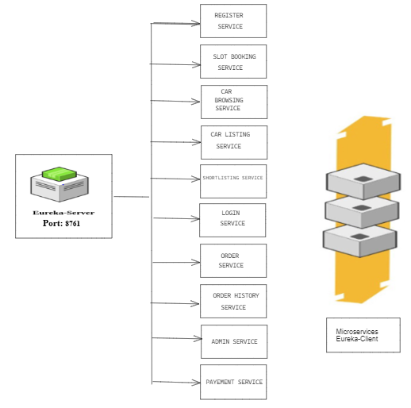
Eureka Server

Slide 16
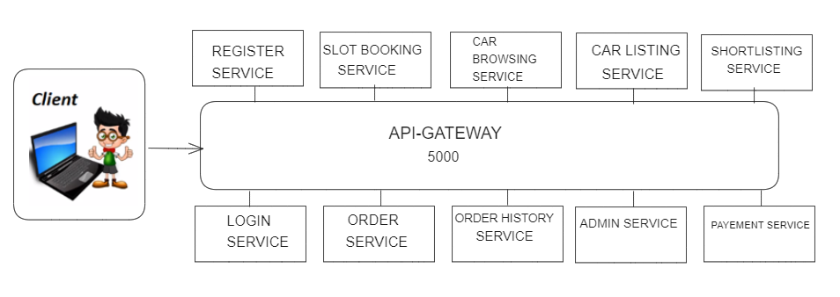
Api-Gateway

Slide 17









Tech Stack
Front End :-
Back End:-
Database:-
Other:-
FEIGN CLIENT

Slide 18
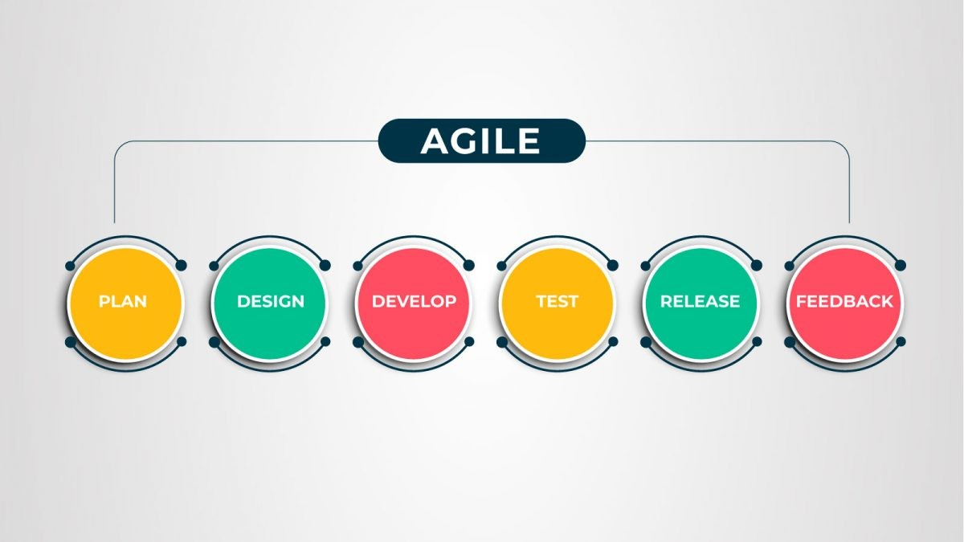
Agile Methodology

Slide 19

Thank You

